Slide 1
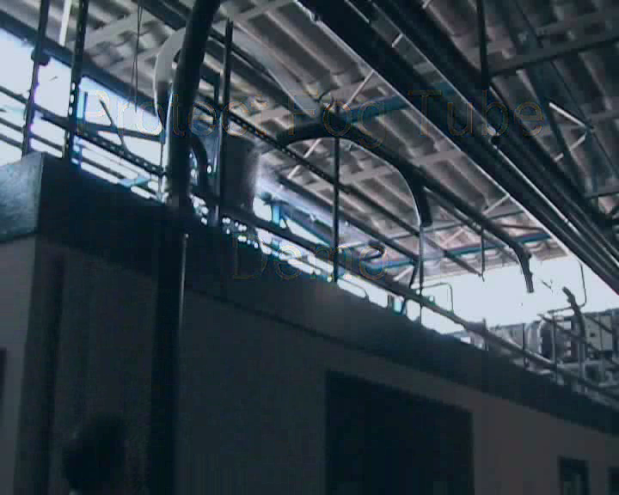
The First Attempt
Connecting to a Fog Cannon
Selecting communication port to use
Setup normally only has to be done
once
Some computers may give problems when using autodetect
Some operating systems will give warnings

Slide 2
Vent System Without Fan
NOT supplied from Protect – buy it locally

Slide 3
